Slide 1
Design patterns

Slide 2
Why Patterns?
What’s New Here is that Nothing is New Here
Patterns are about what works
Patterns give us a way to talk about what works
Patterns distill experience
Patterns give us a pithy design vocabulary

Slide 3
Alexander on Patterns
Patterns in solutions come from patterns in problems.
"A pattern is a solution to a problem in a context."
"Each pattern describes a problem which occurs over and over again in our environment, and then describes the core of the solution to that problem, in such a way that you can use this solution a million times over, without ever doing it the same way twice."
Christopher Alexander -- A Pattern Language

Slide 4
Design Patterns
過去，在實做各種各類的軟體過程中，許多人累積了寶貴的物件導向分析經驗。經過蒐集整理，這些寶貴的繼承架構，class diagram，物件互動架構等等，被蒐集成所謂的 design patterns。
design patterns are one kind of reuse, but not code reuse. Instead, it is a kind of pattern reuse.

Slide 5
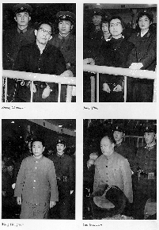
The Gang of Four:
The Essential Field Guide
Design Patterns: Elements of Reusable Object-Oriented Software
Erich Gamma, Richard Helm, Ralph Johnson, and John Vlissides
Addison Wesley, 1995
A landmark book that changed the way programmers think about building object-oriented programs
Notes:
The essential field guide…

Slide 6
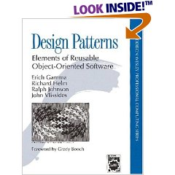

Slide 7
GoF Design Patterns
Creational patterns
  Abstract Factory
  Builder
  Factory Method
  Prototype
  Singleton
Structural patterns
  Adapter
  Bridge
  Composite
  Decorator
  Facade
  Flyweight
  Proxy
Behavioral Patterns
  Chain of Responsibility
  Command
  Interpreter
  Iterator
  Mediator
  Memento
  Observer
  State
  Strategy
  Template Method
  Visitor

Slide 8


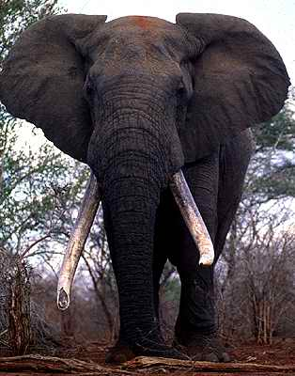



The Big Five
Lion
Leopard
Elephant
Buffalo
Rhino
Composite
Proxy
Strategy
Observer
Visitor
Notes:
I’m a little reticent about using bullet lists here, but what the heck…
Some safari guides like to talk about the “big five”.
I’ve identified five particularly interesting patterns as our safari’s “big five”. My selections are ultimately arbitrary, but are based on various criteria such as prevalence, complexity, and even notoriety...

Slide 9
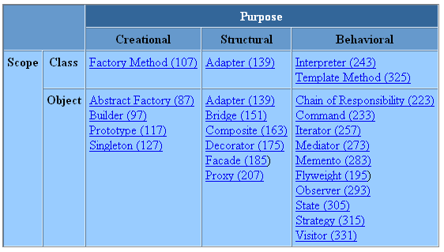
Design patterns essentiels

Slide 10
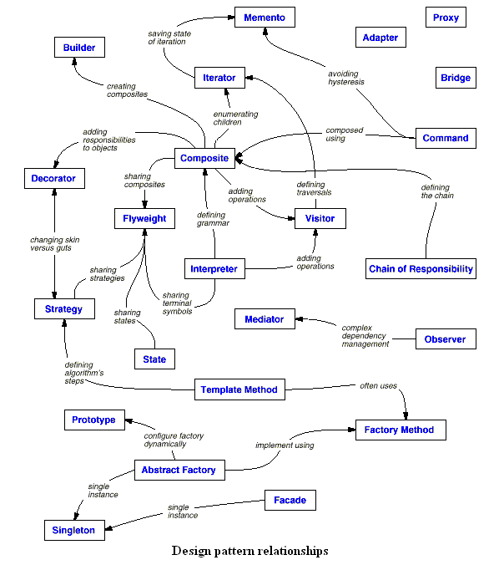

Slide 11
Practice of Design Pattern
In order to achieve flexibility, design patterns usually introduce additional levels of indirection, which in some cases may complicate the resulting designs and hurt application performance.
Often, people only understand how to apply certain software design techniques to certain problems^{[citation needed]}. These techniques are difficult to apply to a broader range of problems. Design patterns provide general solutions, documented in a format that does not require specifics tied to a particular problem.

Slide 12
Criticism
Targets the wrong problem
The need for patterns results from using computer languages or techniques with insufficient abstraction ability. Under ideal factoring, a concept should not be copied, but merely referenced. But if something is referenced instead of copied, then there is no "pattern" to label and catalog. Paul Graham writes in the essay Revenge of the Nerds.
Peter Norvig provides a similar argument. He demonstrates that 16 out of the 23 patterns in the Design Patterns book (which is primarily focused on C++) are simplified or eliminated (via direct language support) in Lisp or Dylan

Slide 13
Criticism
Leads to inefficient solutions
The idea of a design pattern is an attempt to standardize what are already accepted best practices. In principle this might appear to be beneficial, but in practice it often results in the unnecessary duplication of code. It is almost always a more efficient solution to use a well-factored implementation rather than a "just barely good enough" design pattern.

Slide 14
Criticism
Passionate (Patterners) force their code into this pattern and that pattern they typically miss the fact that they are more often than not INCREASING complexity rather than following Fowler's first rule of KISS (keep it simple and stupid). Other than that they seem like genuinely intelligent people. Go figure.
Design pattern make code obscure and difficult to understand
"The OVERUSE is worst thank NO USE it at all“
Is important to understand and use all these things, but more important is how and where to use them

Slide 15
Criticism
I would also like to add that sometimes extensive use of design patterns is overkill. Some problems, especially if the requirements and future change is very predictable and stable, can be solved very easily without employing design patterns. It's also fair to say that once a developer/designer is fluent in the use of design patterns he/she can incorporate them into a solution as easily as using any other design construct. But this doesn't mean that the next guy who comes along and is going to maintain that project or make some changes to it has the same intimacy with design patterns as the first designer therefore we have another overkill. To sum up, design patterns should be used wisely and where needed and like any other tool that we have at our disposal if you try to fix everything using design patterns you're going to end up in a big mess.

Slide 16

My Comments

Slide 17

In real world
As a programmer
  You have deadline
  you have so many features to catch on
  You have so many bugs to fix
  acceptable, usable v.s. best, optimal

Slide 18
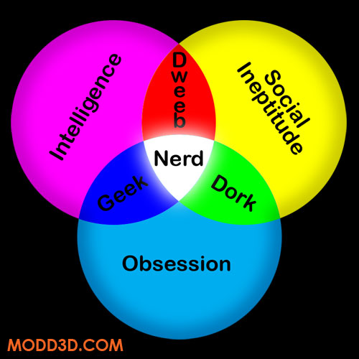

Do not turn yourself into

Slide 19
My Words
SE, OO are meant to solve software development problem in practical world
The real world is dirty
It is impractical to build a pure, perfect, optimal software in practice.
In human history, software evolve and advance gradually.
every thing has a price (cost)

Slide 20
Meet the ugly truth
if (type == "wop") {
assert(false);
xp.type = T_WOP ;
xp.wop_nodetype = this ;
xp.val_wop = _wop;
} else if (type == "varname") {
xp.type = T_STRING ;
xp.val_string = _wop->getName();
} else if (type == "int*") {
xp.type = TP_INT ;
WOP_Int_Proxy * iwop = dynamic_cast<WOP_Int_Proxy*>(_wop);
assert(iwop != NULL) ;
xp.val_int_ptr = iwop->getIntValAddr();
//xp.original = _wop->getVal();
} else if (type == "int") {
xp.type = T_INT ;
WOP_Int_Proxy * iwop = dynamic_cast<WOP_Int_Proxy*>(_wop);
assert(iwop != NULL) ;

Slide 21
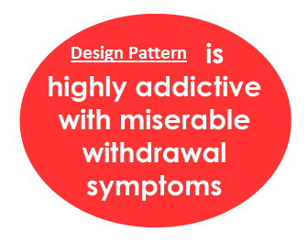
Suggestions
Plot a draft design and code first
Unless it is clear that a design pattern is necessary, otherwise, focus on solving the problem itself.
Discover the problems of your implementation and its extension and future change
See through the nature of your problem and find a design pattern to address it.

Slide 22
Singleton
Rationalle and Motivation
The singleton pattern applies to the many situations in which there needs to be a single instance of a class, a single object. It is often left up to the programmer to insure that the
An important consideration in implementing this pattern is how to make this single instance easily accessible by many other objects.
example
  one system can have many printers but only a spooler instance
  a file system can have many files but there is only one

Slide 23
Singleton
Timing
  當類別只能有一個物件個體，而且要給外界一個方便的單一窗口
  這唯一的物件也必須能透過繼承加以擴充

Slide 24
Singleton - implementation
class Singleton {
public:
static Singleton* Instance(); // gives back a real object!
static proof(void); // proof that the object was made
protected:
Singleton(); // constructor
private: static Singleton* _singleton;
};
Singleton* Singleton::_singleton = 0;
Singleton* Singleton::Instance() {
if (_singleton == 0) { _
singleton = new Singleton;
} // endif
return _singleton;
} // end Instance()
No class can use the constructor to new a singleton object

Slide 25
Composite
在圖形編輯器這種圖形化應用程式裡，常會用小零件拼出複雜的圖形，也會將幾個小零件結合成較大的群組物件。這個群組物件又可以當成零件來拼出更大的圖形。欲達此目的，直覺能想到的就是採用下面的 class diagram 繼承架構，其中group 是一個所謂的容器物件。

Slide 26
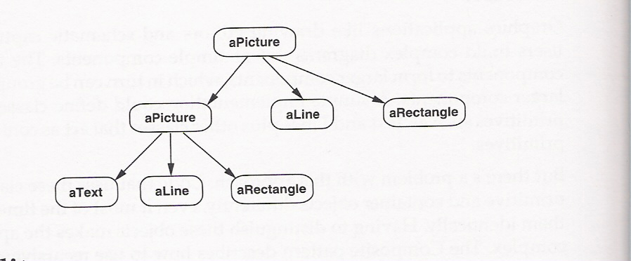
Composite object

Slide 27
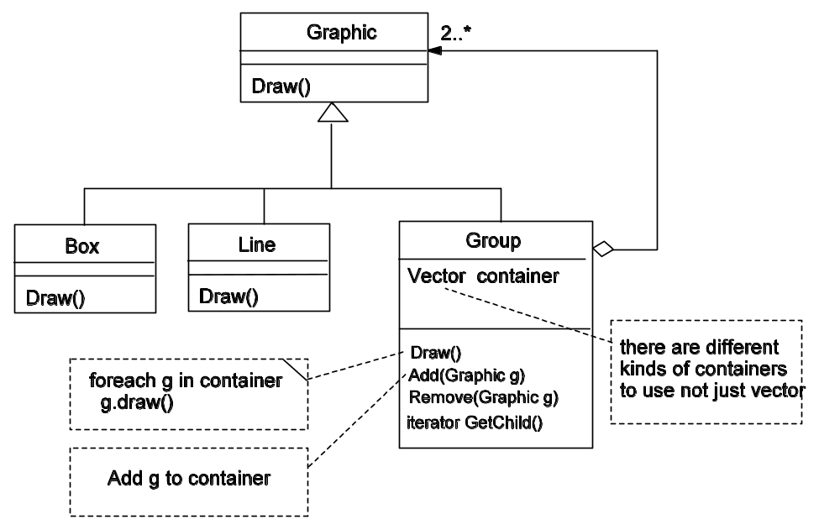
Composite object – The first solution

Slide 28
Problem??
但是問題來了，譬如你們的 umleditor usecase D.2 要去ungroup一物件。假設使用者事先點選了某一個物件，然後到Edit Menu選擇ungroup 的功能。若被點選的物件記錄在 selected這個變數，這時候你不得不寫下下面的一段 code
MENU_EDITactionperformed() {
if (selected instanceof Group)
// 我們要把selected 的所有child 物件移除，再加入 AllObjectList
for all child c in selected.getChild()
selected.remove(c);
add c to AllObjectList ;
delete selected
} else {
// do nohing
}
}
bad OO design smells?

Slide 29
Comments
我們所碰到的問題是，我們的程式碼要去判斷一個物件到底是基底物件還是group 物件
一般繼承的規則都告訴我們，特異化的行為應該留在sub class 就好。

Slide 30
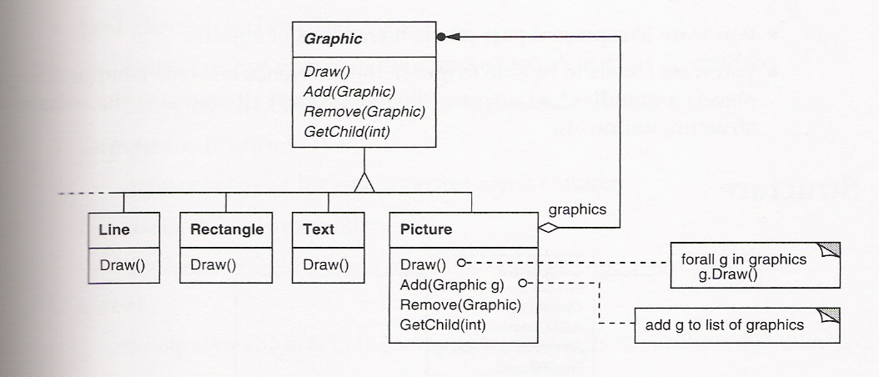
The right solution
Percolating
up
percolating up

Slide 31
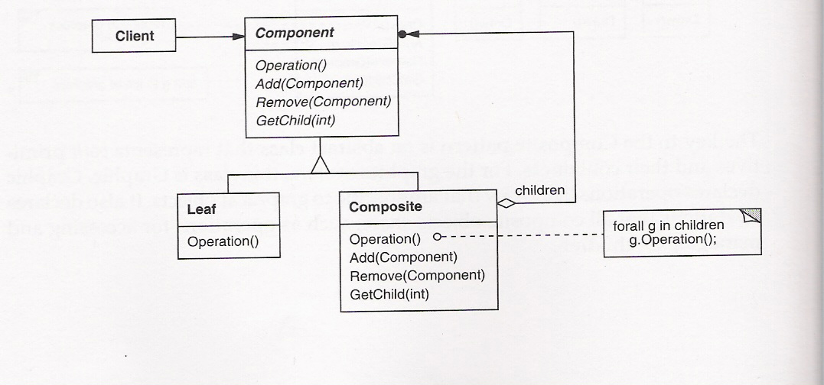
Composite Design pattern

Slide 32
Sample code
class Equipment { public: virtual -Equipment(); const char* Name() { return _name; } virtual Watt Power(); virtual Currency NetPrice(); virtual Currency Discountprice(); virtual virtual virtual Virtual void Add(Equipment*); Virtual void Remove(Equipment*); protected: Equipment(const char*); private: const char* _name; Iterator<Equipment*>* Createlterator(); }

Slide 33
class CompositeEquipment : public Equipment {
public:
virtual -CompositeEquipment();
virtual Watt Power();
virtual Currency NetPrice();
virtual Currency Discountprice();
virtual void Add(Equipment*);
virtual void Remove(Equipment*);
virtual Iterator<Equipment*>* Createlterator();
protected:
CompositeEquipment(const char*);
private:
List<Equipment*> _equipment;
} ;
class FloppyDisk : public Equipment {
public:
FloppyDisk(const char*);
virtual -FloppyDisk();
virtual Watt Power();
virtual Currency NetPrice();
virtual Currency Discountprice();
} ;

Slide 34
class Chassis : public compositeEquipment {
public:
Chassis(const char*);
virtual -Chassis();
virtual Watt Power();
virtual Currency Netprice(); virtual Currency Discountprice();
} ;
Cabinet * cabinet = new Cabinet("PC Cabinet");
Chassis* chassis = new Chassis("PC Chassis");
cabinet->Add(chassis);
Bus* bus = new Bus ("MCA Bus");
bus->Add(new Card("l6Mbs Token Ring");
chassis->Add(bus);
chassis->Add(new FloppyDisk("3.5in Floppy“);
cout << "The net price is " ? chassis->NetPrice() ? end

Slide 35
Proxy pattern
我們想要延緩一個物件的建立與初始化，原因是物件的建立與初始化需要速度與記憶體等等代價
我們希望當物件真正需要的時候才進行建立與初始化（on demand)
  例如一份文件中的許多影像物件
但是這個延緩的過程應該物件自行處理掉，例如讀檔的程式碼不需要處理這些細節

Slide 36
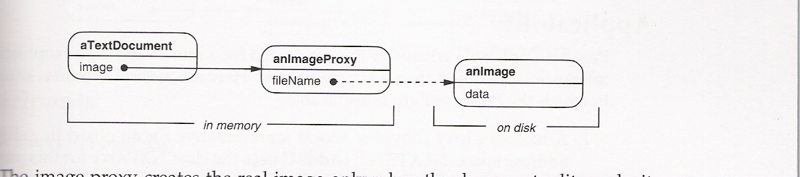

Slide 37
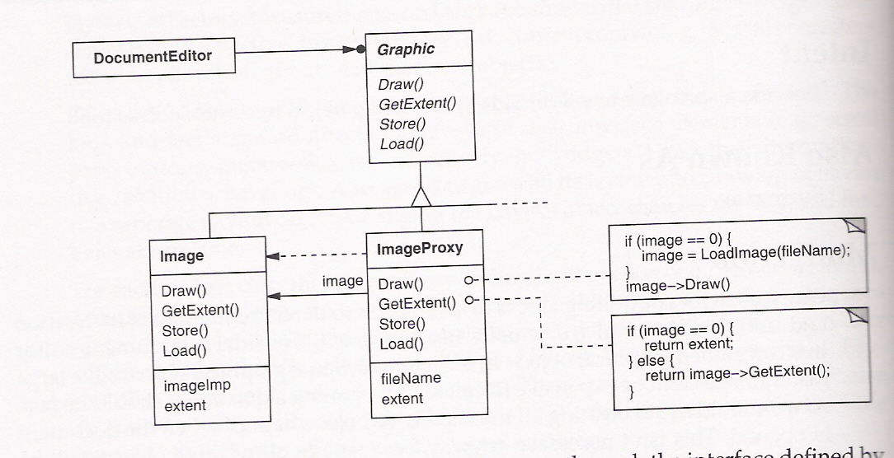

Slide 38
Sample code
class Graphic {
public:
  virtual -Graphic();
  virtual void Draw(const Point& at) = 0;
  virtual void HandleMouse(Event& event) = 0;
  virtual const point& GetExtent() = 0;
  virtual void Load(istream& from) = 0;
  virtual void Save(ostream& to) = 0;
  protected:
  Graphic () ;
} ;

Slide 39
class Image : public Graphic {
public:
Image(const char* file); // loads image from a file
virtual -Image();
virtual void Draw(const point& at);
virtual void HandleMouse(Event& event);
virtual const point& GetExtent();
virtual virtual private: I I ...
void Load(istream& from);
void Save(ostream& to);
};

Slide 40
Imageproxy has the same interface as Image:
class Imageproxy : public Graphic (
public:
  ImageProxy(const char* imageFile);
  virtual -ImageProxy();
  virtual void Draw(const point& at);
  virtual void HandleMouse(Event& event);
  virtual const point& GetExtent();
  virtual void Load(istream& from);
  virtual void Save(ostream& to);
protected:
Image* GetImage();
private:
Image* _image;
Point _extent;
char* _fileName;
} ;

Slide 41
ImageProxy::Imageproxy (const char* fileName) {
_fileName = strdup(fileName);
_extent = Point::Zero; // don't know extent yet _image = 0;
}
Image* Imageproxy: :GetImage() {
if (_image == 0) {
_image = new Image(_fileName);
}
return _image;
}
void ImageProxy::Draw (const point& at) {
GetImage()->Draw(at);
}

Slide 42
Finally, suppose we have a class TextDocument that can contain Graphic objects:
class TextDocument {
public:
TextDocument();
void Insert(Graphic*);
/ / ...
} ;
We can insert an ImageProxy into a text document like this:
TextDocument* text = new TextDocument;
/ / ...
text->Insert(new ImageProxy("anImageFileName“);

Slide 43
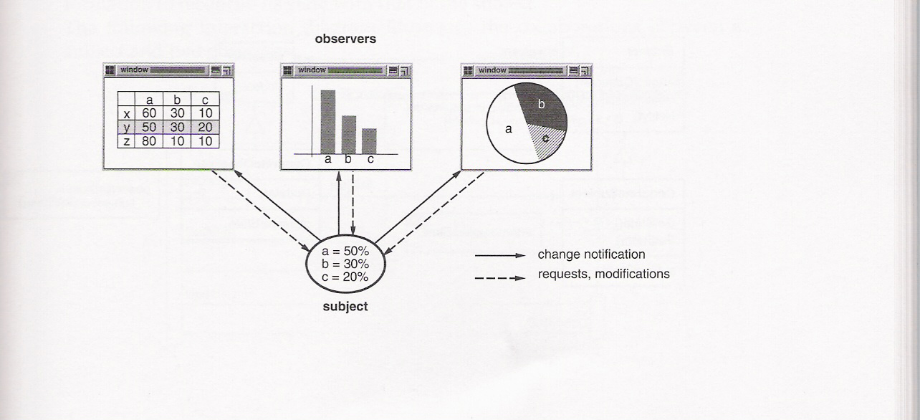
Observer Pattern
Intent: Define a one-to-many dependency between objects so that when one object changes state, all its dependents are notified and updated automatically.

Slide 44
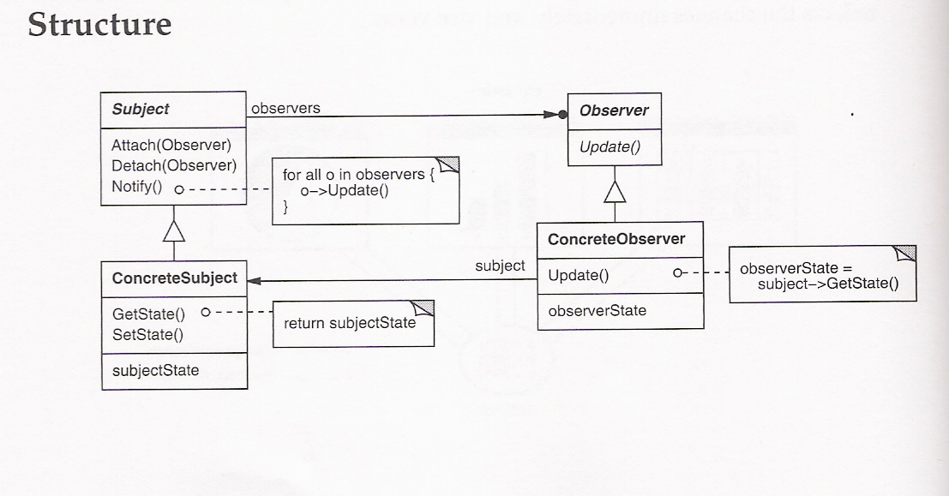

Slide 45
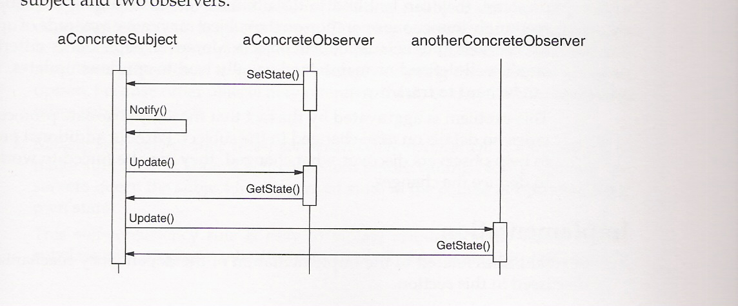

Slide 46
Strategy Pattern
Define a family of algorithms, encapsulate each one, and make them interchangeable. Strategy lets the algorithm vary independently from clients that use it. Also Known As Policy

Slide 47
Motivation
Many algorithms exist for breaking a stream of text into lines. Hard-wiring all such algorithms into the classes that require them isn't desirable for several reasons:
Clients that need linebreaking get more complex if they include the linebreaking code. That makes clients bigger and harder to maintain, especially if they support multiple linebreaking algorithms.
Different algorithms will be appropriate at different times. We don't want to support multiple linebreaking algorithms if we don't use them all.
. It's difficult to add new algorithms and vary existing ones when linebreaking is an integral part of a client.
We can avoid these problems by defining classes that encapsulate different linebreaking algorithms. An algorithm that's ep.capsulated in this way is called a strategy.

Slide 48
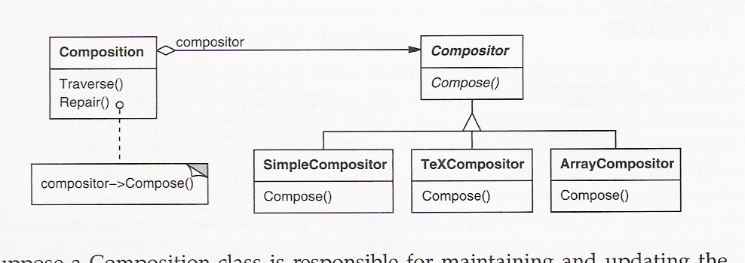

Slide 49
Sample code
Suppose a composition classa
is responsible for maintaining
and updating the linebreaks of text displayed in a text viewer
class Composition {
public:
Composition(Compositor*);
void Repair();
private:
Compositor* _compositor;
Component* _components;
int _componentCount;
int _lineWidth;
int* _lineBreaks;
int _lineCount;
} ;

Slide 50
Strategy 1
class Compositor {
public:
virtual int Compose( Coord natural[], Coord stretch[], Coord shrink[], int component Count , int lineWidth, int breaks[]
) = 0;
protected:
Compositor();
} ;
class SimpleCompositor : public compositor {
public:
SimpleCompositor();
virtual int Compose ( Coord natural[], Coord stretch[], Coord shrink[], int componentCount, int lineWidth, int breaks[]
) ;
II
} ;

Slide 51
Strategy 2
class TeXCompositor : public Compositor {
public:
TeXCompositor();
virtual int Compose ( Coord natural[], Coord stretch[], Coord shrink[], int component Count , int lineWidth, int breaks[]) ;
} ;
class ArrayCompositor : public Compositor public:
ArrayCompositor(int interval);
virtual int Compose ( Coord natural[], Coord stretch[], Coord shrink[], int componentCount, int lineWidth, int breaks[]
) ;
} ;
Strategy 3

Slide 52
To instantiate Composition, you pass it the compositor you want to use:
Composition* quick = new Composition(new SimpleCompositor);
Composition* slick = new Composition (new TeXCompositor);
Composition* iconic = new Composition(new ArrayCompositor);

Slide 53
Visitor Pattern
Represent an operation to be performed on the elements of an object structure. Visitor lets you define a new operation without changing the classes of the elements on which it operates.

Slide 54
Motivation
Consider a compiler that represents programs as abstract syntax trees. It will need to perform operations on abstract syntax trees for "static semantic" analyses like checking that all variables are defined. It will also need to generate code. So it might define operations for type-checking, code optimization, flow analysis, checking for variables being assigned values before they're used, and so on. Moreover, we could use the abstract syntax trees for pretty-printing, program restructuring, code instrumentation, and computing various metrics of a program.
Most of these operations will need to treat nodes that represent assignment statements differently from nodes that represent variables or arithmetic expressions.
Hence there will be one class for assignment statements, another for variable accesses, another for arithmetic expr

Slide 55
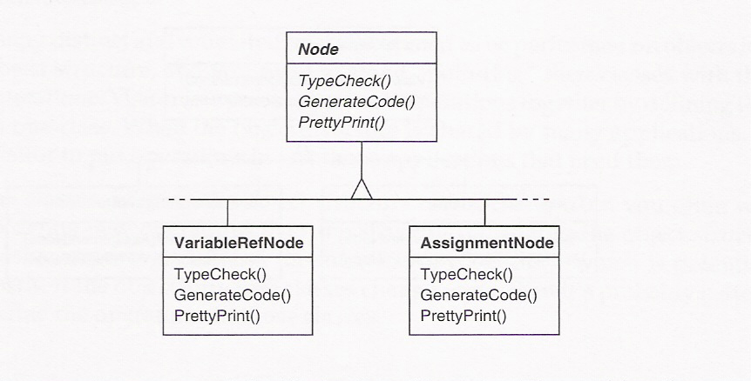

Slide 56
Problem??
The problem here is that distributing all these operations across the various node classes leads to a system that is hard to understand, maintain, and change. It would be confusing to have type-checking code mixed with pretty-printing code or flow analysis code
It would be better if each new operation could be added separately and the node classes were independent of the operations that apply to them

Slide 57
More comments
實際上 typecheck, generatecode 這些visitor都是分別執行的
我們希望這些程式碼不要跟 node的本身資料結構扯在一起
我們希望 visitor 到底是哪一個在拜訪node時再告知node就好了

Slide 58
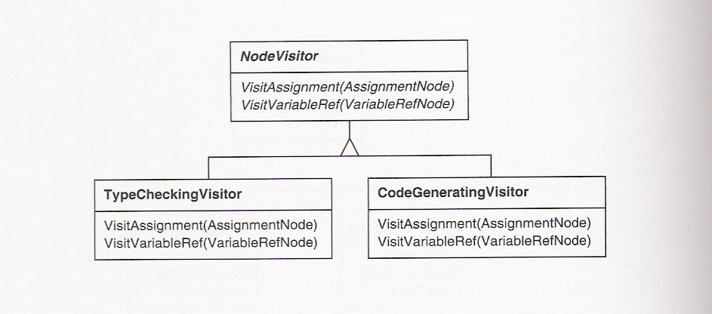
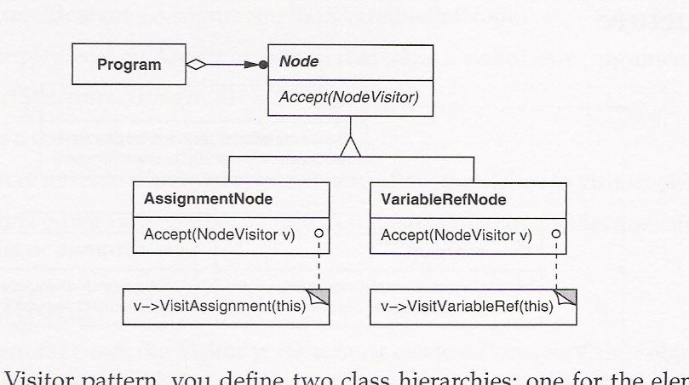

Slide 59
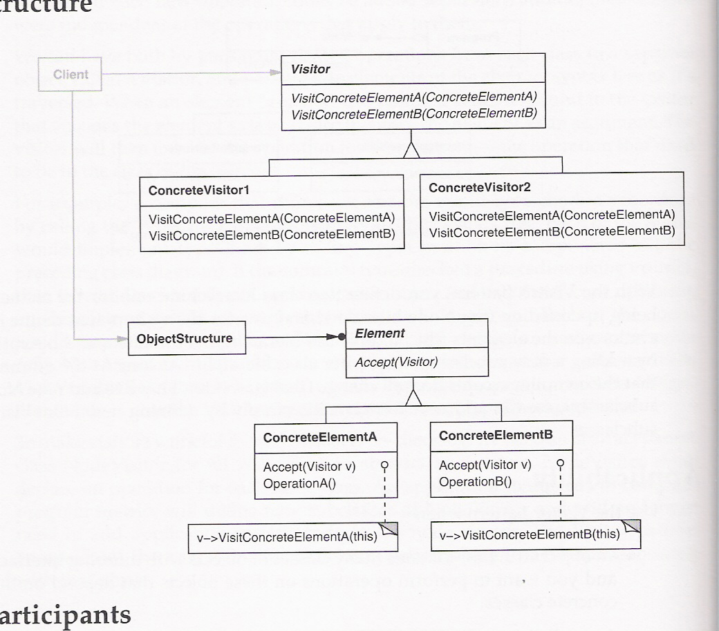

Slide 60
